Slide 1
Optimization
Neural Networks & Fuzzy Logic (BITS F312)
Ashish Patel
Lectures during November 21 - 28, 2017

Slide 2
Non-Traditional Optimization Techniques
Most of the traditional optimization techniques based on gradient methods have the possibility of getting trapped at local minima, depending upon the degree of non-linearity and the initial guess.
Traditional optimization techniques do not ensure the global optimum.
Population based non-traditional optimization techniques such as GA, DE, and PSO uses natural phenomena and are stochastic in nature.

Slide 3
Advantages of Population based Global Optimization Techniques
Doesn’t require derivative information
Searches wide domain of the objective/cost surface
Deals with a large number of variables
Well suited for parallel computers
Optimizes variables with extremely complex cost surfaces (they can jump out of a local minimum)
Suggests possible other solutions for a given design problem with multiple global solutions which may be marginally inferior to absolute global solution but more suitable for implementation

Slide 4
Disadvantages of Population based Global Optimization Techniques
Population based global optimization techniques are not the best way to solve every problem.
For instance, the traditional methods have been tuned to quickly find the solution of a well behaved convex analytical function of only a few variables.
For such cases, the calculus-based methods outperform the global optimization techniques, quickly finding the minimum while the global optimization technique is still analyzing the costs of the initial population.

Slide 5
Genetic Algorithm (GA)
GA was introduced by Holland* in 1975 and popularized by his student Goldberg**
Philosophically, GA is based on Darwin’s theory of survival of the fittest
GA is an optimization and search technique based on the principles of genetics – reproduction, crossover, mutation
GA allows a population composed of many individuals to evolve under specified selection rules to a state that optimizes the function
* Holland, John (1992). Adaptation in Natural and Artificial Systems. Cambridge, MA: MIT Press.
** Goldberg, David (1989). Genetic Algorithms in Search, Optimization and Machine Learning. Reading, MA: Addison-Wesley Professional.

Slide 6
Steps for Genetic Algorithm (GA)
Consider a maximization or minimization problem:
Maximize or Minimize Fitness Function F(x) = f(x) or 1/(1+f(x)) respectively
Initial population range is given as
For unconstrained optimization, boundary values are not applicable to evolved variables whereas for constrained optimization, evolved variables should follow it strictly.
Important steps for GA realization
Variables Encoding
Fitness function Evaluation and Elite Selection
Application of GA operators: Reproduction, Crossover, Mutation
Check boundary conditions and termination criteria

Slide 7
GA variables
GA begins by defining a chromosome or an array of variable values to be optimized.
If the chromosome has N variables (an N-dimensional optimization problem) given by x₁, x₂, . . . , x_{N}, then the chromosome is written as an N element row vector.
chromosome = [x₁, x₂, . . . , x_{N}]
A group of ‘n’ chromosomes form a population of ‘n’ members.

Slide 8
Encoding of GA variables
Coding is the method by which the variables x_{i} coded into string structures.
Binary coding is generally used to translate the range of the function variables. This essentially means that a certain number of initial guesses are made within the range of the function variables and these are transformed into a binary format.
Length of the binary coding is generally chosen with respect to required accuracy.

Slide 9
For l_{i} - bit binary encoding, there are 2^{li} combinations or codes possible. Accuracy in variable values are given by
Following linear mapping rule is used for the purpose of l_{i} - bit binary encoding:
where S_{j} ∈ {0, 1}

Slide 10
If we take l-bit binary encoding for each of N variables of the chromosome, then the chromosome will be represented by continuous bit pattern of N×l bits.
Here, starting from left, first l bits represent variable x₁, next l bits represent variable x₂, and so on. Pictorially it is shown below for a particular chromosome with bit positions mentioned with respect to MSB.
Bit 1 Bit 9 Bit 17
001100111110001100001001……………..11000001
x₁ x₂ x₃ x_{N}

Slide 11
Evaluation of GA Fitness Function
GA works on the principle of “survival of the fittest”.
The ‘good points’ or the points which yield larger values for the function have higher probability to continue in the next generation. The ‘bad points’ or the points which yield smaller values for the function have lower probability to continue in the next generation.
GA maximizes a given function, so it is necessary to transform a minimization problem to a maximization problem. This transformation does not alter the location of the minimum value.

Slide 12
Depending upon whether initial objective function f(x) needs to be maximized or minimized, the fitness function F(x) is defined as:
F(x) = f(x) for maximization problem
F(x) = 1/(1+f(x)) for minimization problem
The fitness function value for a particular coded string is known as the string’s fitness and it is used to decide whether a particular string carries on to the next generation or not.
Best performing chromosomes can be guaranteed to move to next generation using Elite Count (EC), a non-zero and positive constant.

Slide 13
Reproduction
Reproduction operation is also known as Selection operation since this operation decides the strings from current population to be selected for Crossover and Mutation operations in order to generate remaining (n – EC) members.
The end result of this operation is the formation of a ‘mating pool’ where strings are selected in a probabilistic manner using following rule:
Probability of selection into mating pool ∝ Fitness value of string

Slide 14
Probability of selection of the i^{th} string into the mating pool is
where F_{i} is the fitness of the i^{th} string, n is the population size
For minimization problem, we needed to maximize its probability of selection. That is the reason behind defining the fitness function as F(x) = 1/(1+f(x)).

Slide 15
Roulette wheel based selection operation has following steps:
Using F_{i}, calculate p_{i}.
Calculate the cumulative probability P_{i}.
Generate n random numbers between 0 and 1.
Copy the string that represents the chosen random number in the cumulative probability range into the mating pool.

Slide 16
Crossover
Crossover operation forms offspring chromosomes for next generation by using parent chromosomes from the mating pool of the current generation. Parent chromosomes chosen from mating pool are random since they resulted from probabilistic roulette wheel selection operation.
For Single-point crossover operation, a random crossover site, say integer H, is chosen such that 0 ≤ H ≤ N×l, and all the bits to the right of the H^{th} position i.e. (H+1)^{th} bit onwards in the two parent strings are swapped to get two children strings.

Slide 17
Single-point crossover at site 11 is illustrated below for 16-bit chromosome:
Crossover site
Parent 1: 00110010111 000110 Offspring 1: 00110010111 011100
Parent 2: 01110101000 011100 Offspring 2: 01110101000 000110
What happens if the crossover sites are H = 0, N×l.
Crossover operation introduces randomness into the current population to avoid getting trapped in local searches.

Slide 18
Crossover operation may result in better or worse strings. If few worse offsprings are formed, they will not survive for long since upcoming generations reproduction will eliminate them.
What if majority of new offsprings are worse? To avoid such situations, we do not select all strings from the mating pool of current population for reproduction.
If crossover probability is p_{c}, then we use following number of crossover parents (CP) to generate equal numbers of crossover children (CC): CC = round(p_{c} ×(n – EC))

Slide 19
Crossover operation can be summarized as follows:
Select crossover parents (CP) from mating pool resulted by selection operation to generate equal numbers of crossover children (CC): CC = round(p_{c} ×(n – EC)).
Select first two pairs of strings and generate a random integer number between 0 to N×l to decide single-crossover site.
Perform single-crossover operation by swapping all the bits to the right of crossover site
Repeat previous two steps for remaining pairs of strings

Slide 20
Mutation
Mutation involves making changes in the population members directly, that is, by flipping randomly selected bits in certain strings.
The aim of mutation is to change the population members by a small amount to promote local searches when the optimum is nearby.
Mutation is performed by deciding a mutation probability p_{m} and selecting strings from mating pool of selection operation on which mutation is to be performed.

Slide 21
Mutation operation can be summarized as follows:
Select mutation parent (MP) from mating pool resulted by selection operation to generate mutation child (MC): MC = (n – EC – CC).
Generate random numbers to decide whether mutation is to be performed on a particular bit of the population member or not.
If the random number is greater than mutation probability, do no flip particular bit (no mutation for the bit). Otherwise, flip the particular bit (bit is mutated).

Slide 22
Next Generation Population
Following is order for next generation population of size = 20, elite count = 2, and crossover probability = 0.8.
Elite 1
Elite 2
Crossover child 1
Crossover child 2
...
Crossover child 14
Mutation child 1
...
Mutation child 4

Slide 23
Next Generation Population
Elite members are updated in each iteration of GA, depending on fitness value of population members.
In each iteration, first fitness value is calculated and then elite members are elected.
So elite count (EC) remains 2, but elite members change depending on fitness values in that iteration.
Cross over count (CC) and mutation (MC) count also remain same, but members on which these operations are performed are changed depending on their fitness and selection process.

Slide 24
Termination criteria
Following termination criteria can be used to Stop GA procedure.
Maximum number of Generations, say G = 100, is reached.
After certain number of generations, say G = 50, change in fitness function values for two consecutive generations is less than threshold value, say
{(f_{G=52})-(f_{G=51}) < 10⁻⁶.

Slide 25
Numerical Example for GA
Use unconstrained GA to minimize the objective function:
f(x₁, x₂) = x₁ - x₂ + 2x₁² + 2x₁x₂ + x₂²
Following additional information are provided:
(a) Boundary values of variables: 0 ≤ x₁, x₂ ≤ 6.
(b) 10-bit binary encoding of variables (x₁, x₂) represent initial population, given in Table 1.
(c) Take elite count = 2, crossover probability = 0.8, mutation probability = 0.05.
(d) Random number in generation 1 for Roulette wheel selection operation, is given in Table 1.
(e) From the mating pool, first take required numbers of consecutive strings for crossover operations and then take required number of consecutive strings for mutation operations.
(f) Assume Single-point crossover sites as 11, 9, 1, 12, 10, 17, 5 for respective crossover operations.
(g) Assume following bits have probability less than 0.05: bit 9 for mutation parent 1; bit 15 for mutation parent 2; bit 2 for mutation parent 3: bit 5 for mutation parent 4.
Show calculations for first generation to obtain (i) linearly mapped initial population (ii) fitness function (iii) elite children (iv) mating pool (v) crossover children (vi) mutation children (vii) next generation population.

Slide 26
Table 1
String no | Initial x₁ (binary) | Initial x₂ (binary) | random no. for Roulette wheel selection
0 | 1110111011 | 1001010000 | 0.612
1 | 1101001101 | 1111100011 | 0.441
2 | 1100001111 | 0101010011 | 0.713
3 | 0110110100 | 1010100111 | 0.923
4 | 1000111111 | 1111010101 | 0.245
5 | 1011010011 | 1111101011 | 0.651
6 | 1111101110 | 1101001110 | 0.885
7 | 1010100100 | 1011011101 | 0.775
8 | 1010000001 | 1100101111 | 0.348
9 | 0000000001 | 1100011000 | 0.812
10 | 1011101100 | 0001110110 | 0.745
11 | 1110000110 | 0010101010 | 0.029
12 | 0010101001 | 0000001010 | 0.164
13 | 1001001011 | 1111100011 | 0.786
14 | 0001111110 | 1101110111 | 0.887
15 | 1010100000 | 0011100001 | 0.326
16 | 0000101010 | 0100011100 | 0.734
17 | 1111001000 | 1001011000 | 0.639
18 | 0010101010 | 0010101011 | 0.998
19 | 1110100000 | 1010010100 | 0.008

Slide 27
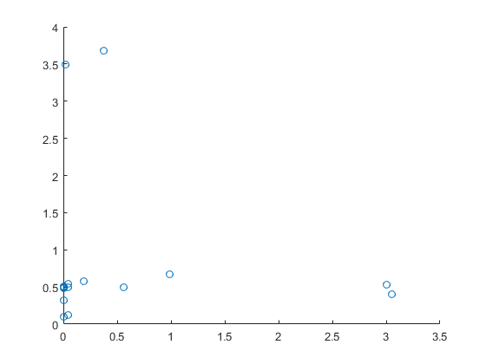
Solution
After 30 iterations, X = [ 0.0 0.504], f(X) = -0.25

Slide 28
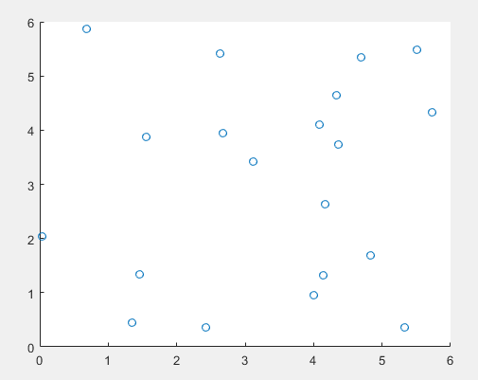
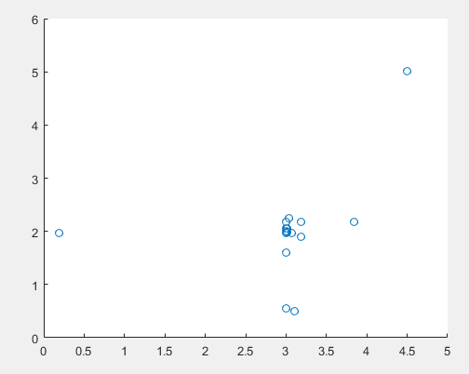
GA- Example 2
f(x₁, x₂) = (x₁² + x₂ - 11)²+(x₁ + x₂² - 7)²
After 30 iterations X = [3.003 2.000]
f(X) = 0.000

